Slide 1

Universities in busan
https://studyinbusan.com

Slide 2
Topics covered
Folder Structure
Landing Page
Register Page
Login Page
Profile Page
University details Page
Register a University Page
Admin Dashboard Page
About us Page

Slide 3
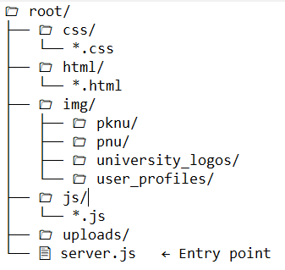
FOlder structure

Slide 4

Landing page

Slide 5
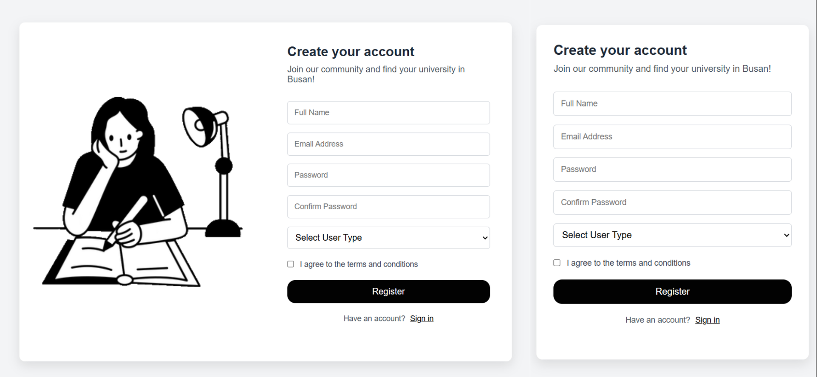

Register page

Slide 6
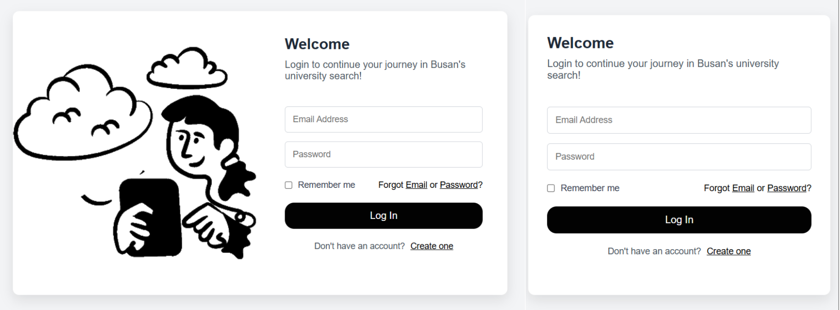

Login page

Slide 7
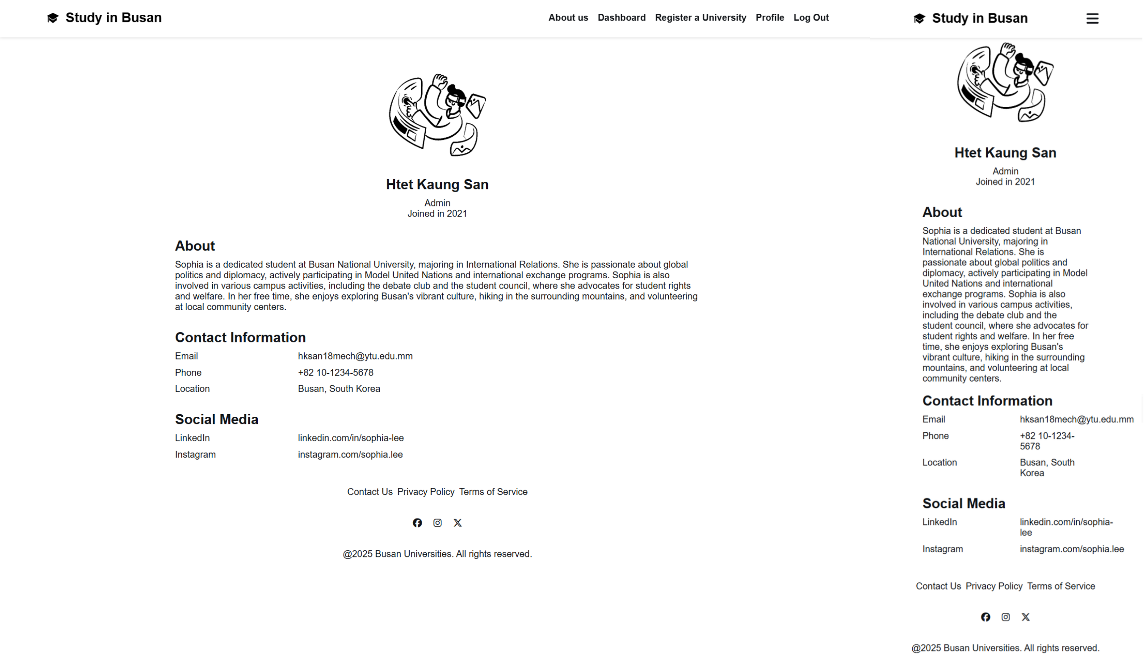

Profile

Slide 8
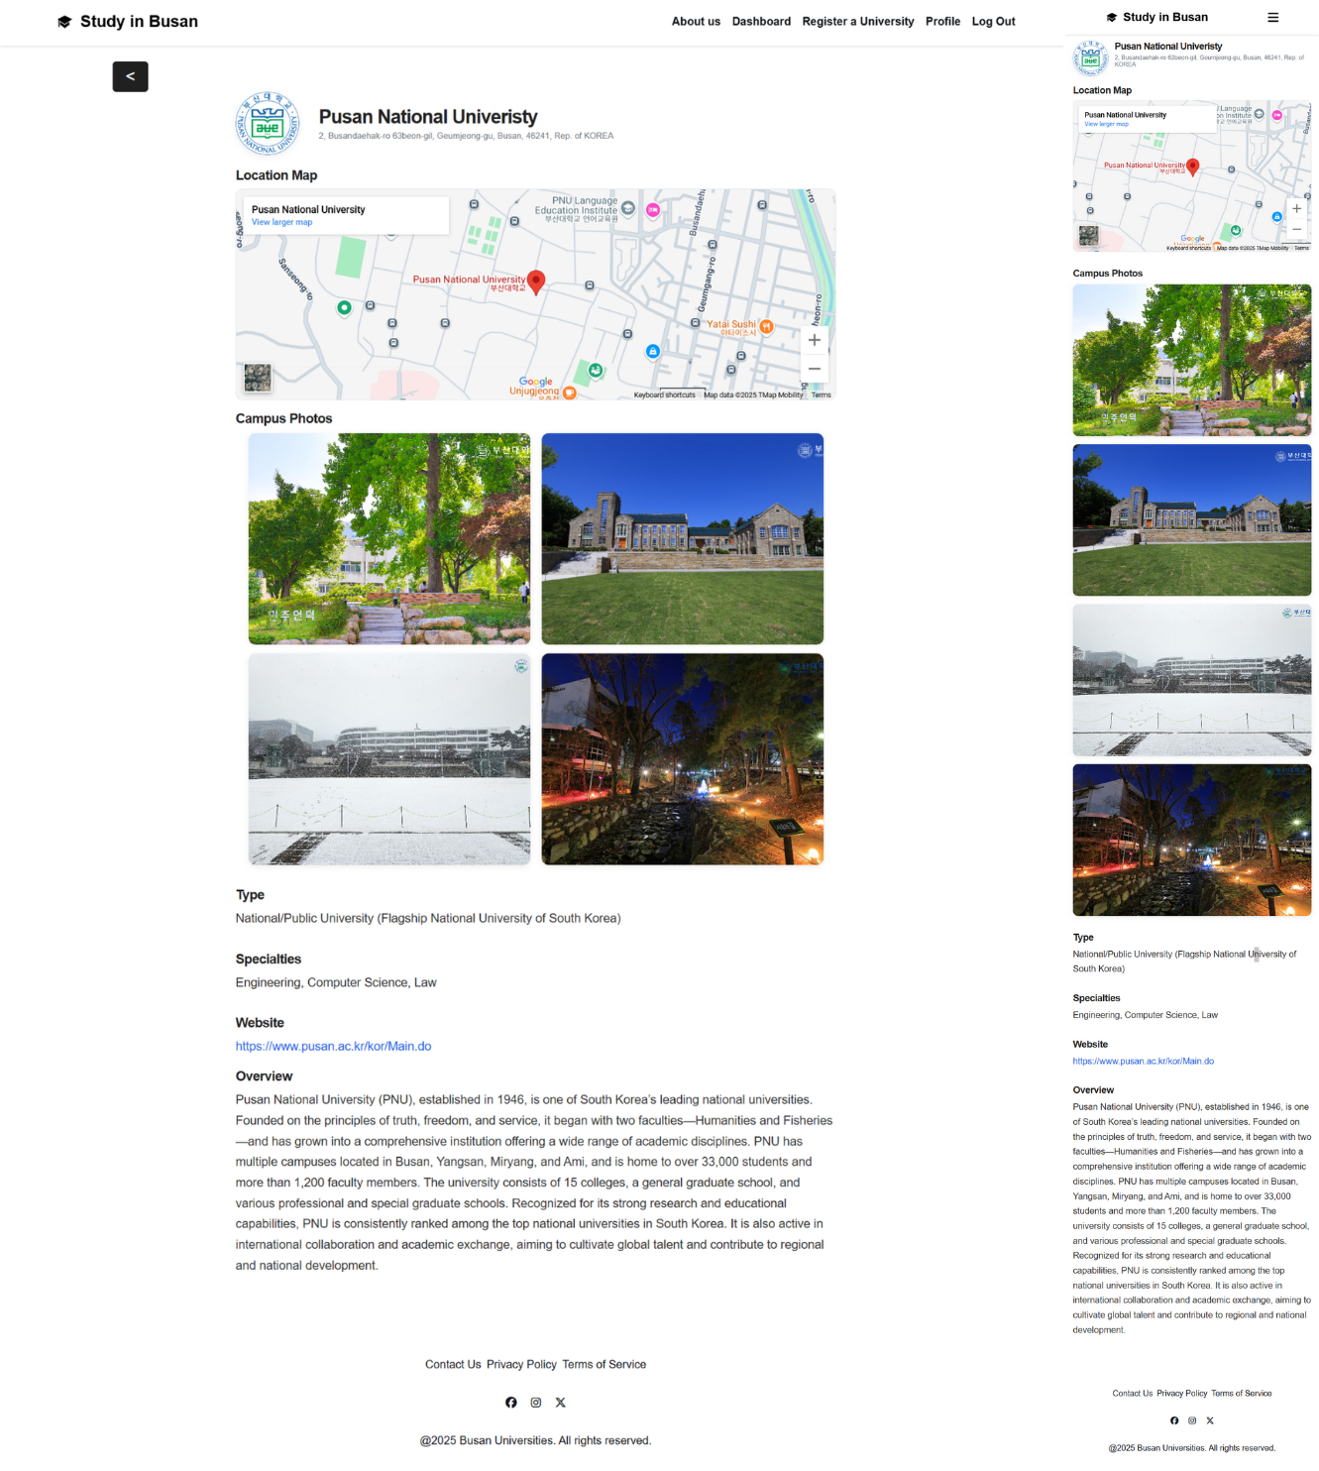
University details page

Slide 9
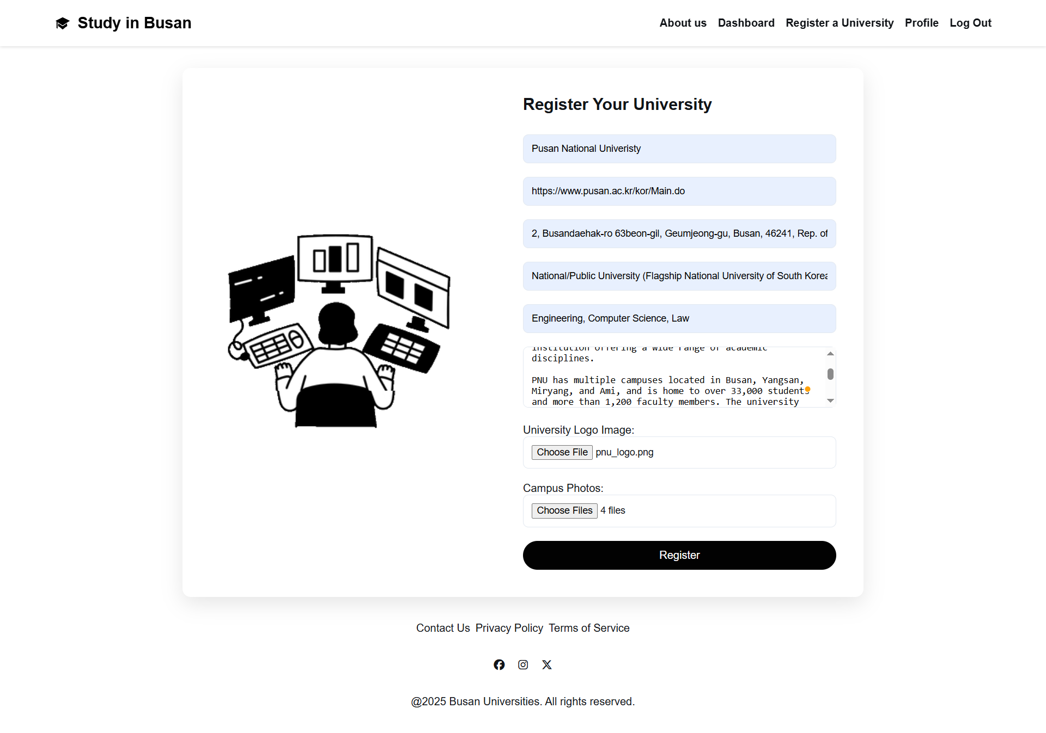
University registration page

Slide 10
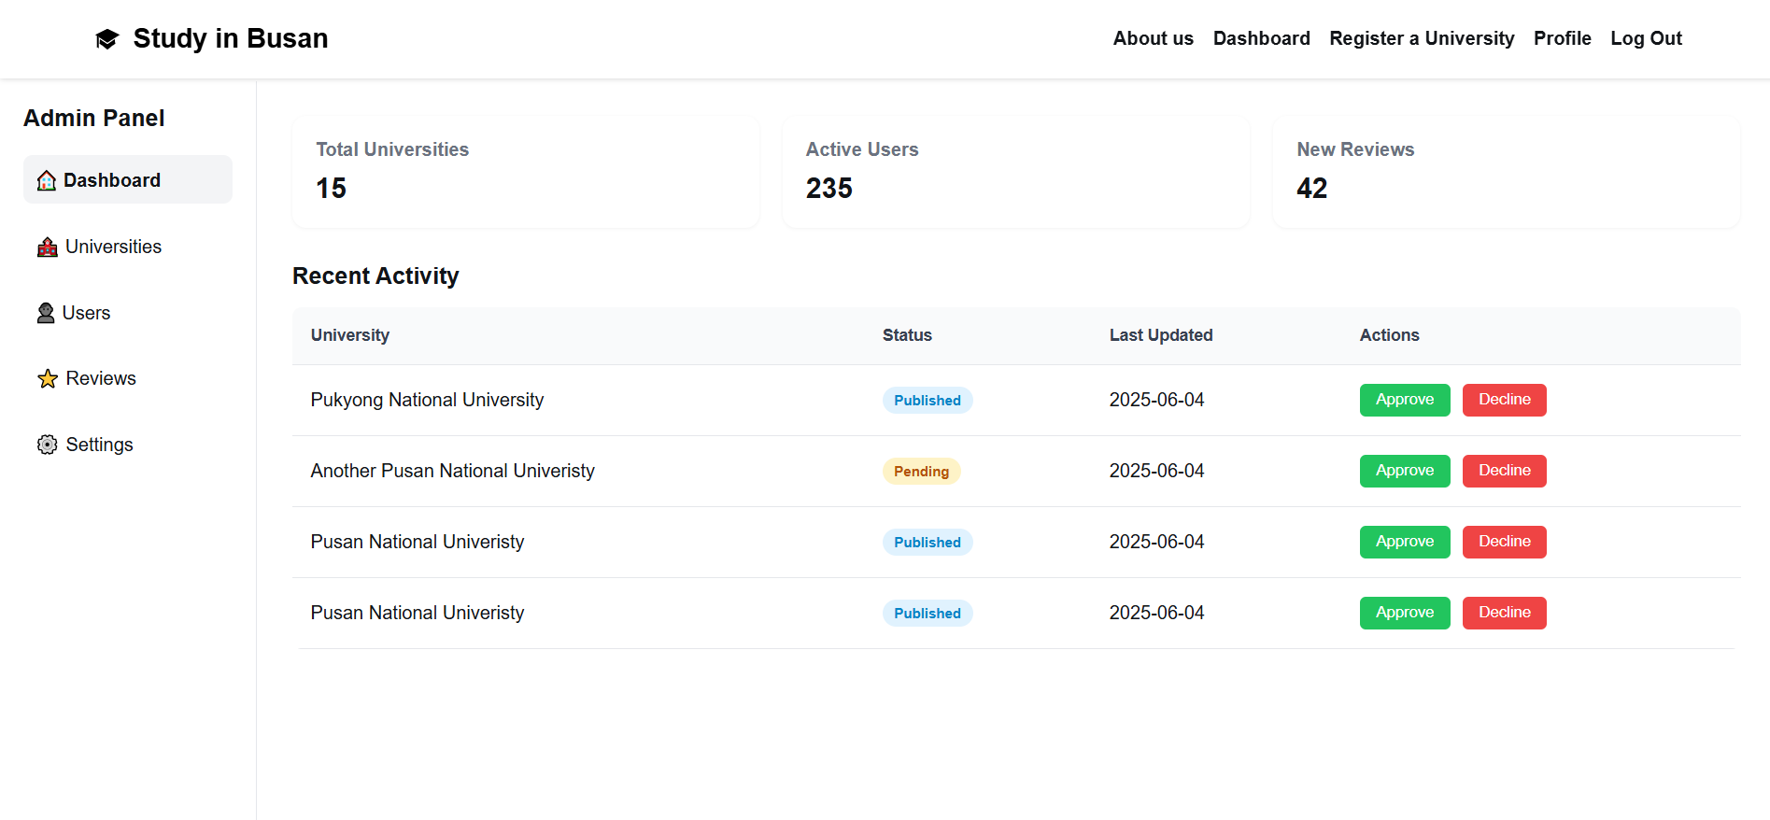
Admin dashboarD

Slide 11
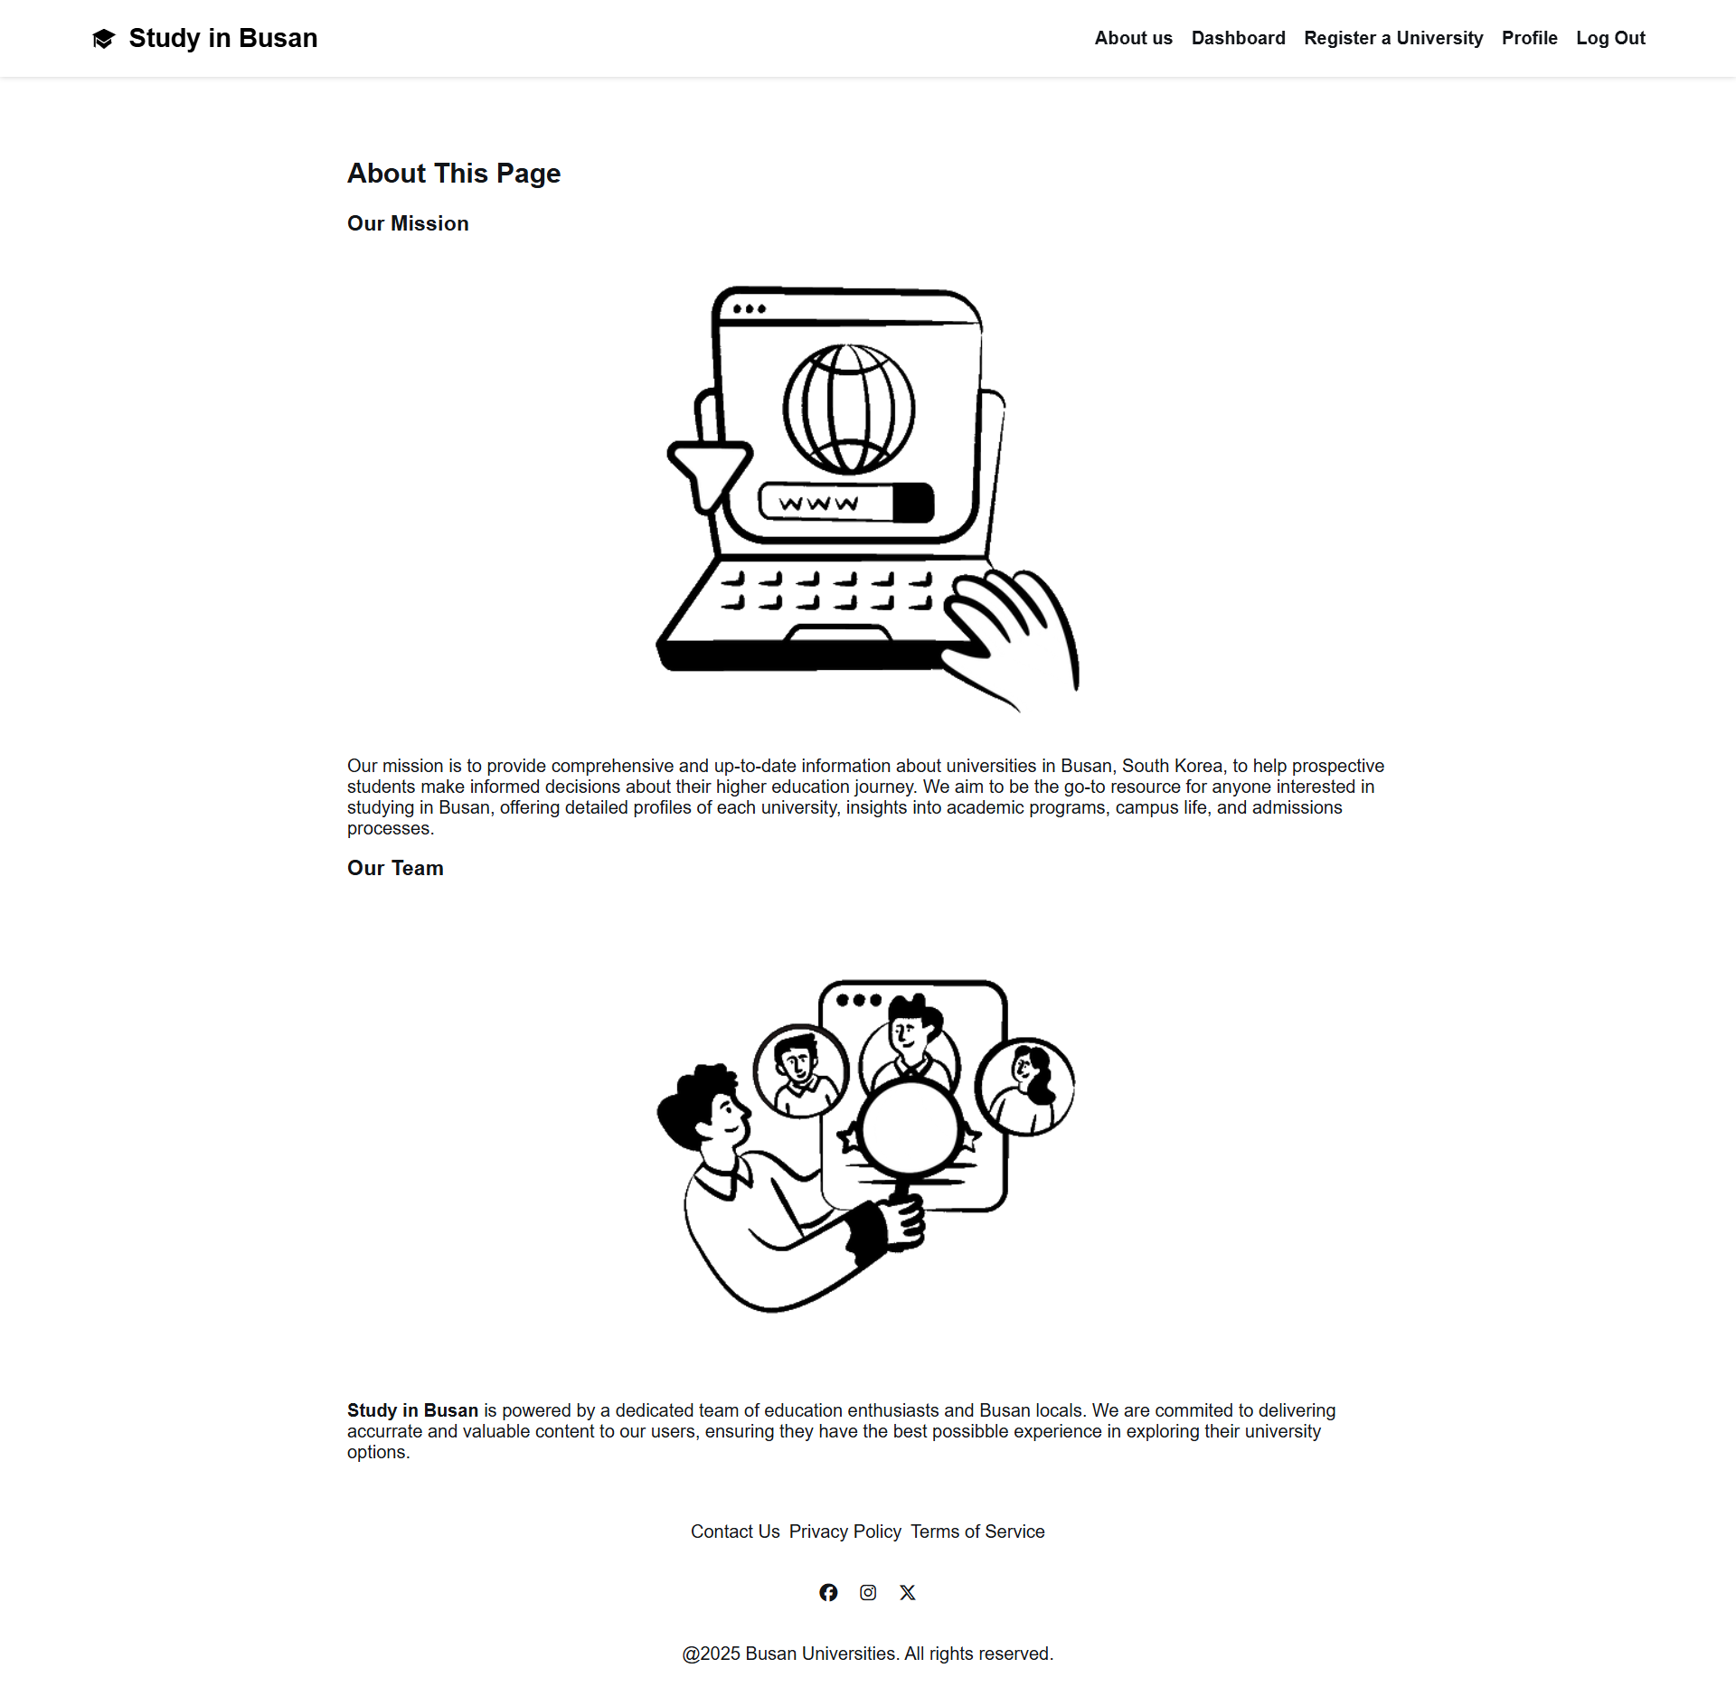
About us

